Slide 1

Major Project-1(CA301P) Odd Semester Session 2025-26
Fake News Detection
SUJAL GUPTA 2426MCA189
SHIVAM CHAUDHARY 2426MCA339
SHUBHRANSHU 2426MCA708
TANYA SINGH 2426MCA2503
Project Supervisor:
Ms. Shruti Aggarwal
Dr. Neelam Rawat

Slide 2



Slide 3

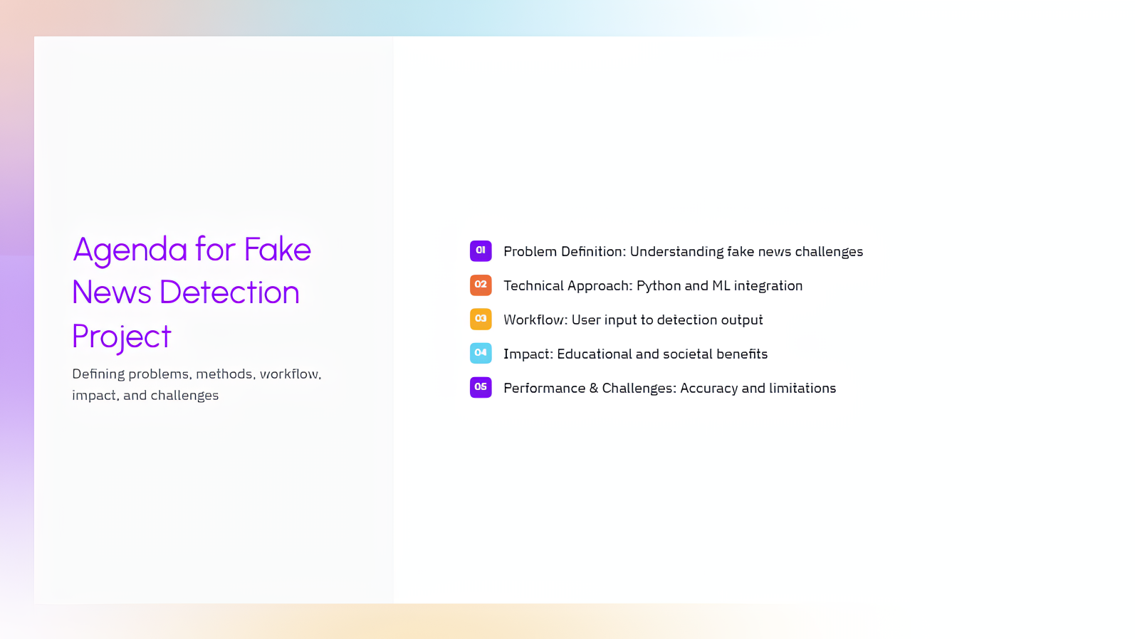

Slide 4
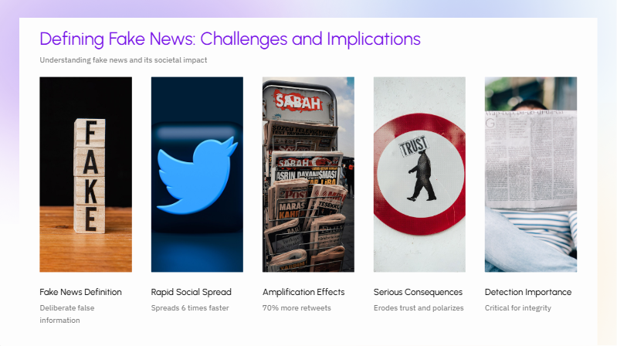


Slide 5



Slide 6
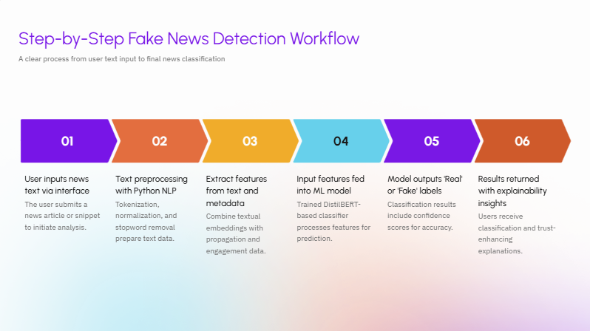


Slide 7
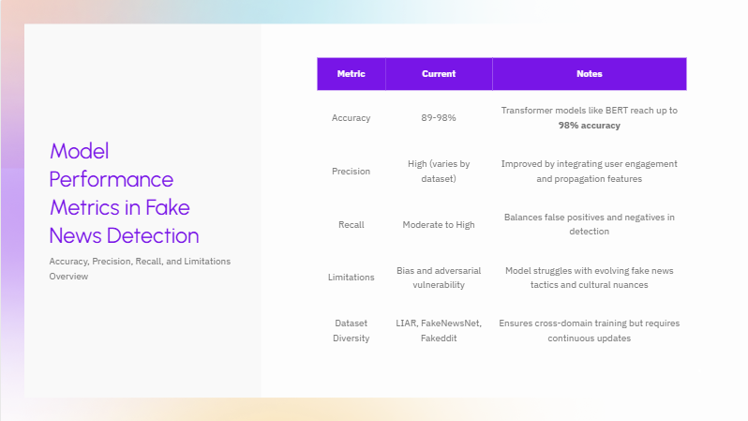
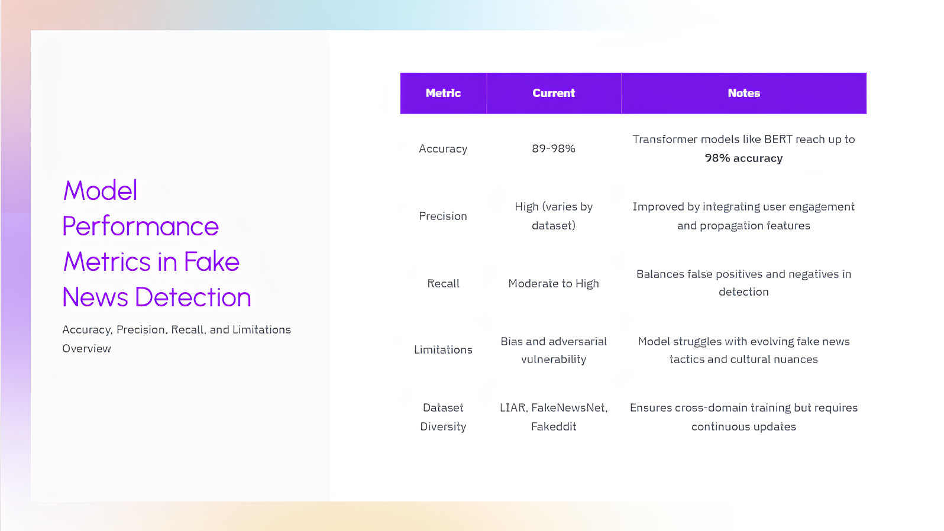

Slide 8



Slide 9
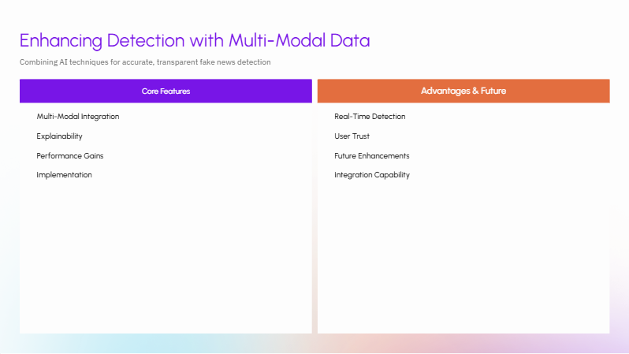
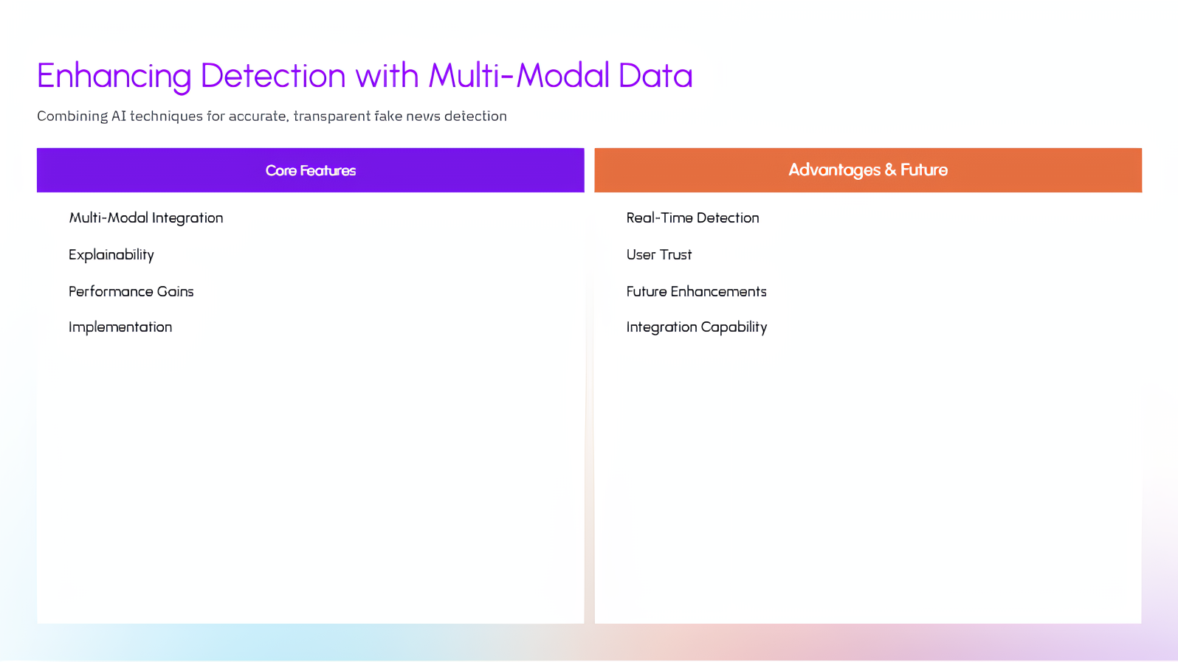

Slide 10
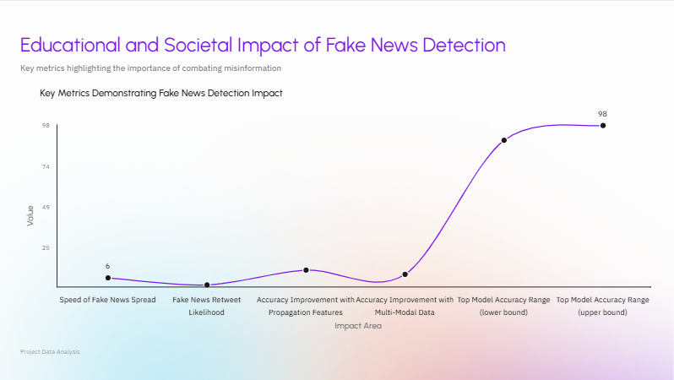

Slide 11
Thank You

